Slide 1

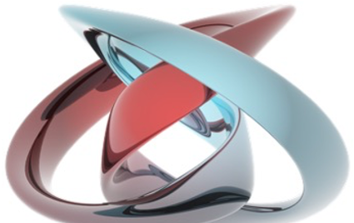
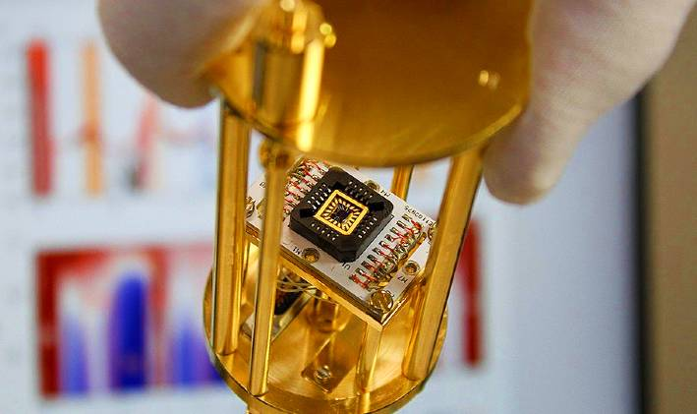
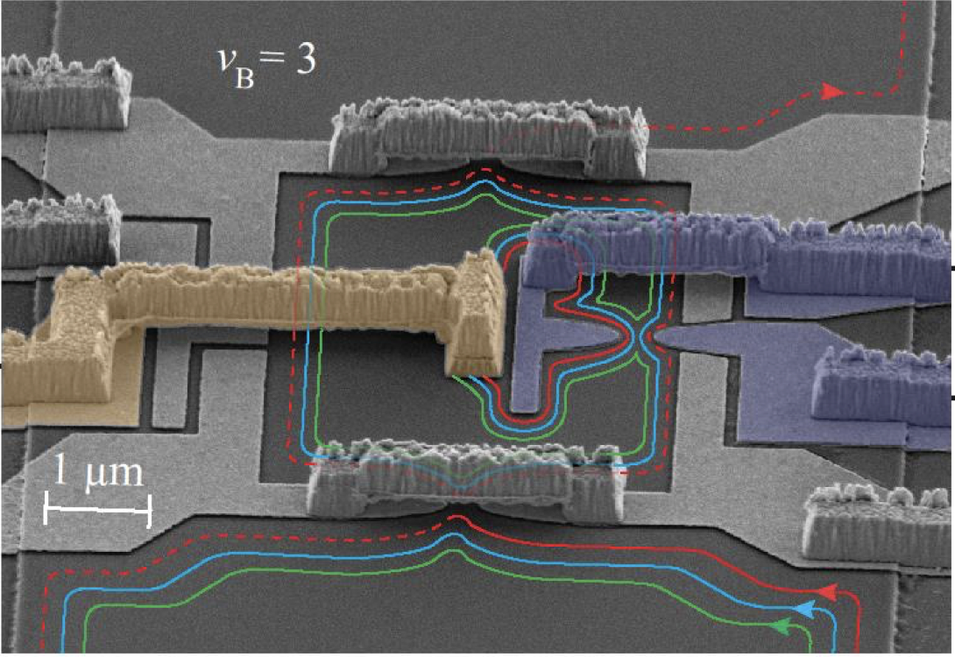
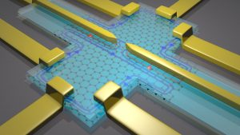
Laboratory of Quantum Physics: Topology and Correlations
Quantum transport in Mesoscopic systems
(PHYS-462)

Slide 2
why 2D electrons….heart of present transistors
high mobility electrons, gate controlled
exchange statistics of 2D electrons is rich
exotic states

Slide 3
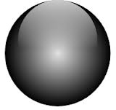
exchange statistics in 3d
bosons
fermions
both

Slide 4
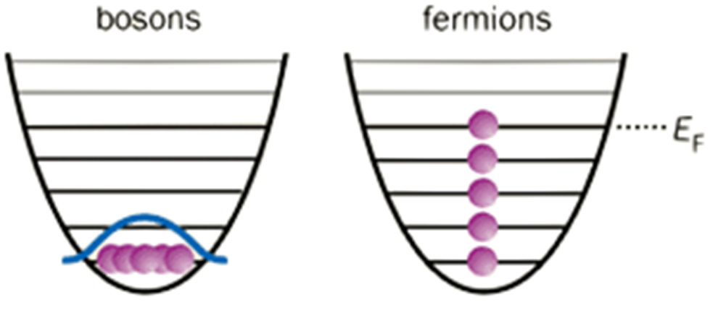
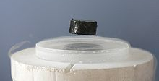
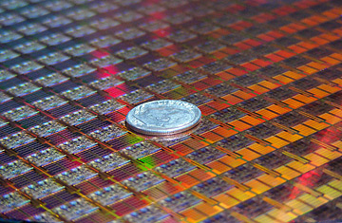
consequences…
bosons
fermions

Slide 5
anyonic statistics in 2d → abelian (Laughlin qp’s)
anyons

Slide 6
anyonic statistics in 2d → non-abelian
degenerate ground state
exchange → unitary
non-abelian anyons

Slide 7
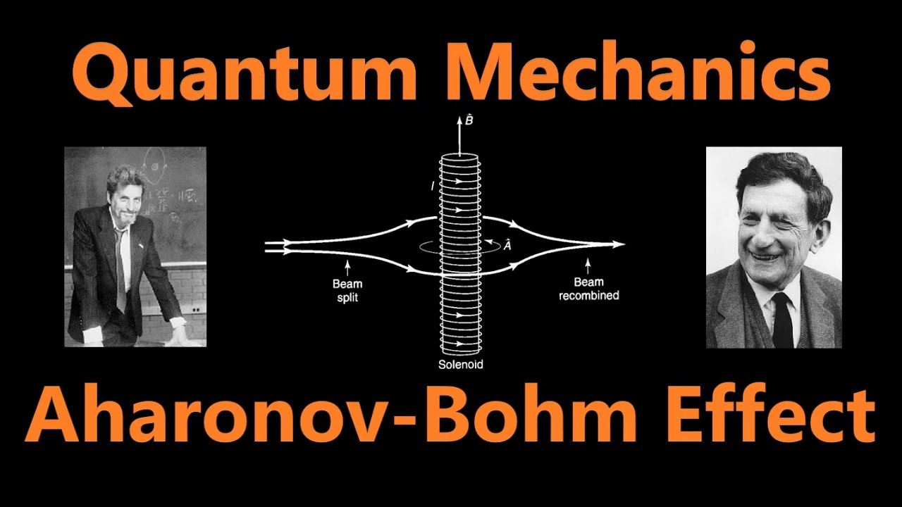

Slide 8
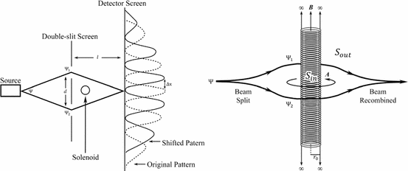
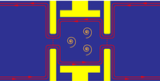
QHE – naturally available edge modes

Slide 9
anyons in QHE

Slide 10
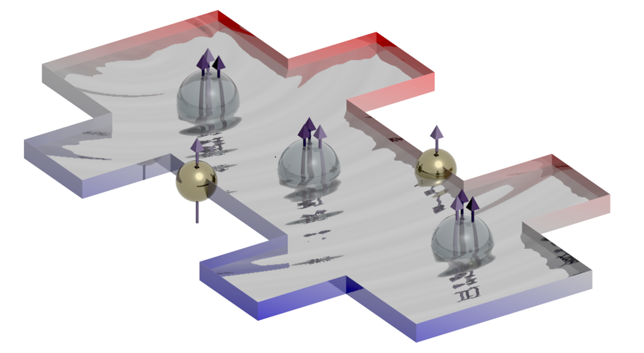
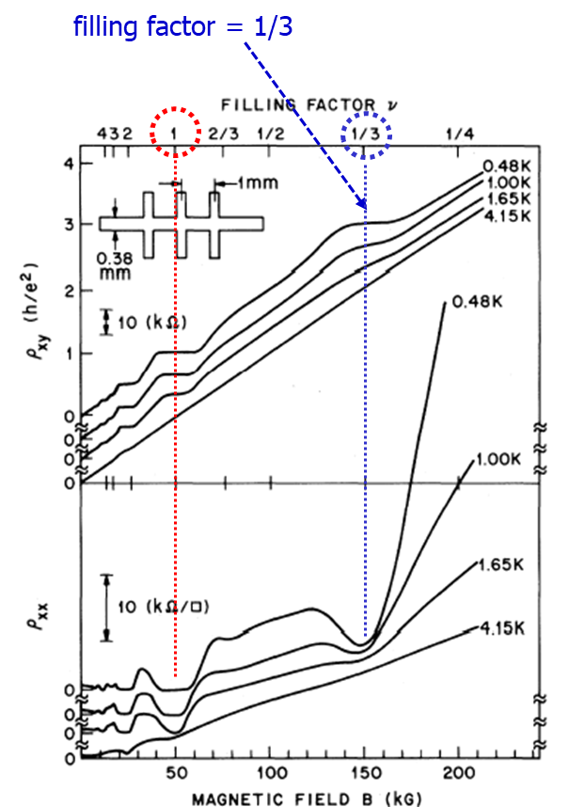
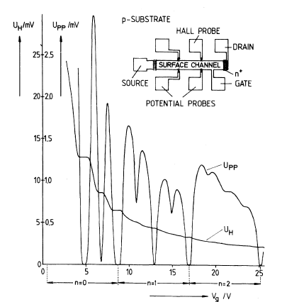
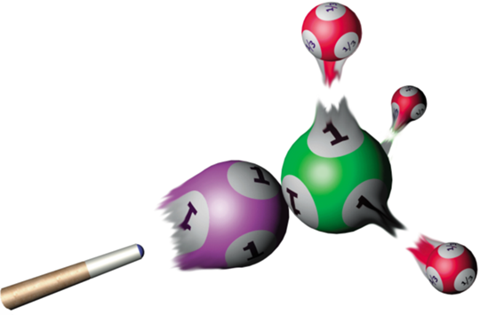
few preliminaries….
previous supporting experiments
1982
1980
R_{H} = (ν e ²/h )⁻¹

Slide 11
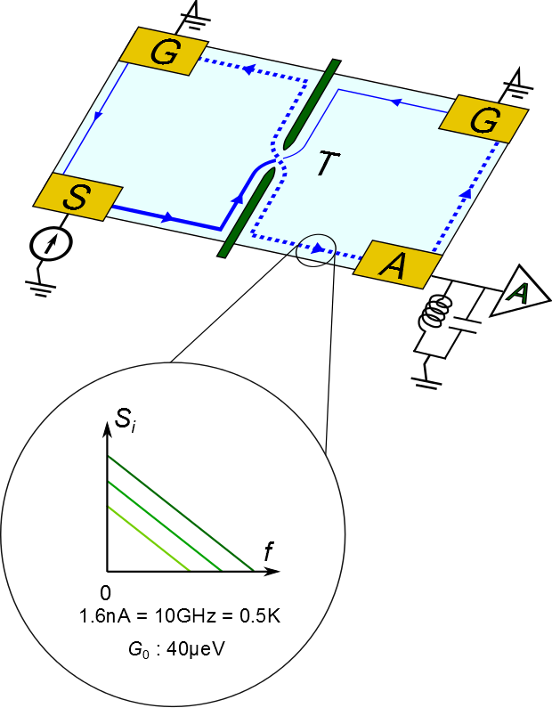
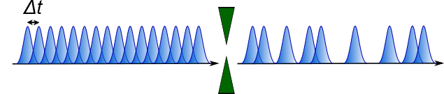
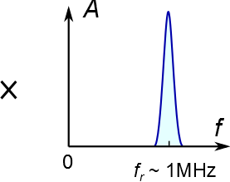
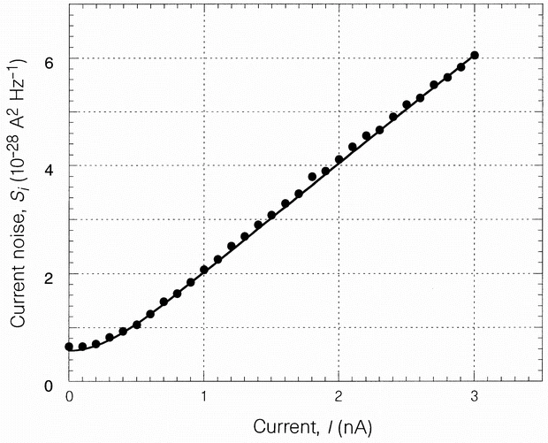
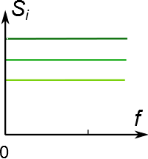
shot noise in QHE
Amplifier sees only R_{Q}
zero noise, Pauli
noise, S_{i}
t
1/f
T = 57mK
transmission = 0.37
low frequency
Fano = 1

Slide 12
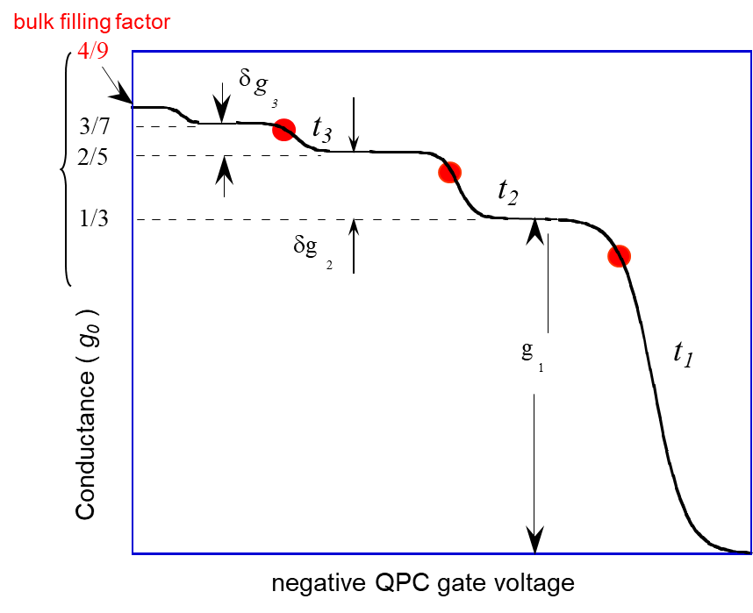
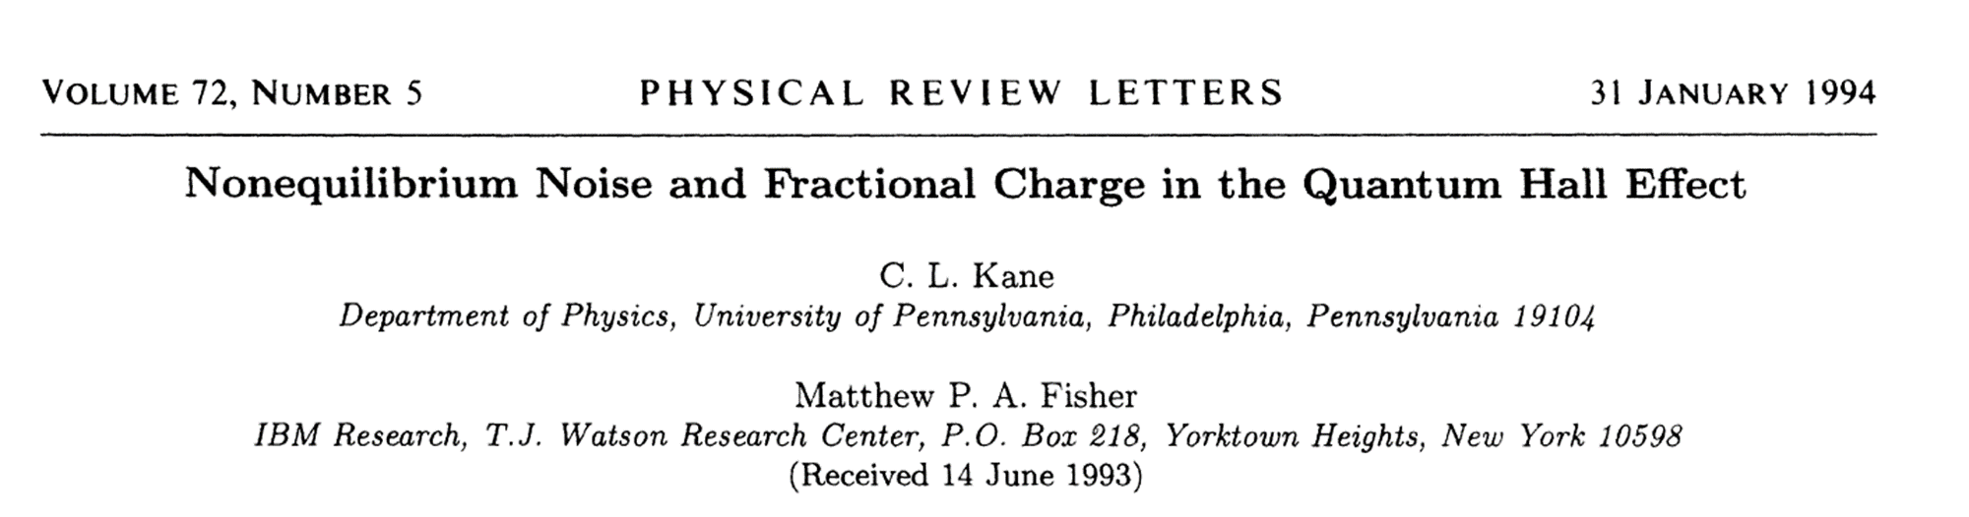
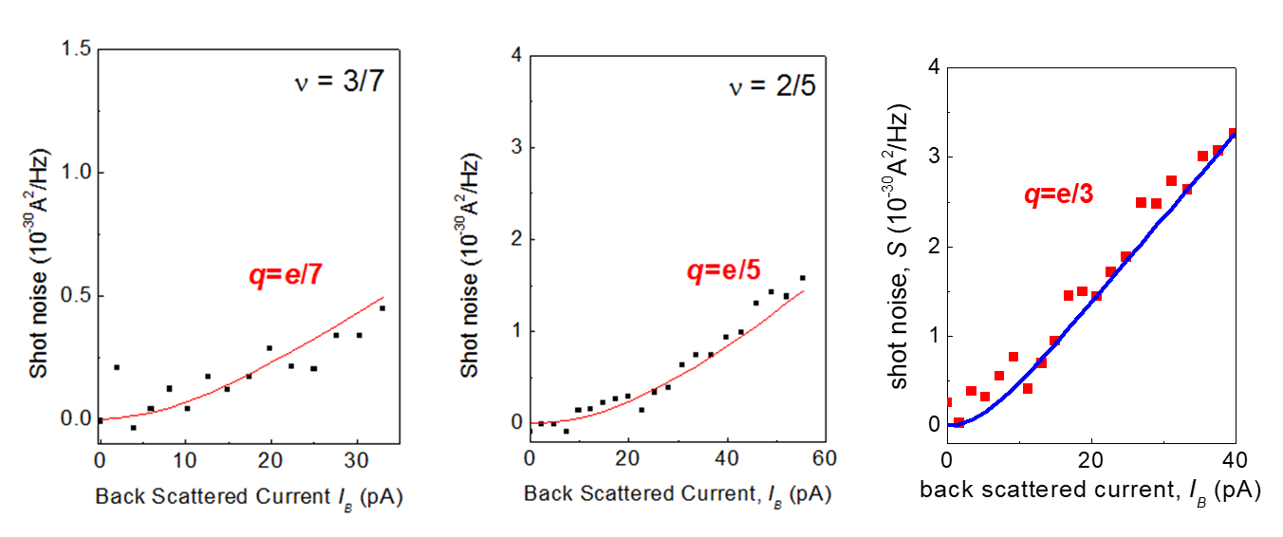
fundamental charge measured
Fano = e*
T=25-50 mK
ν=1/3
De-Picciotto, Nature 1997
Reznikov, Nature 1999
1997-2000

Slide 13
fractional charges in higher fillings
ν=2/5
ν=2/5
F=2/5
F=e*=e/5
Fano = filling = 2/5
fundamental (elementary) charge e/5
Chung, PRL 2003

Slide 14
and …..3/7
likely lower temperature needed…
Fano → state filling
fundamental charge e/7
Chung, PRL 2003

Slide 15
and …..3/7
Chung et al
likely lower temperature needed…
Fano → state filling
charge e/7
most particle states support non-topological neutral modes
Inoue, Nat. Comm. 2014

Slide 16
what about e – h conjugated states ?
here, upstream neutral modes are topological
few examples at…10-15 mK

Slide 17
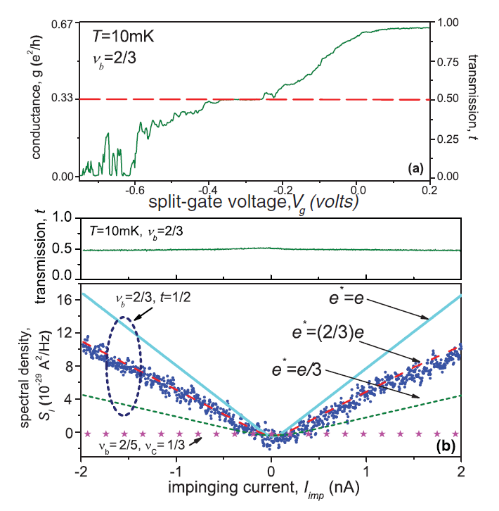
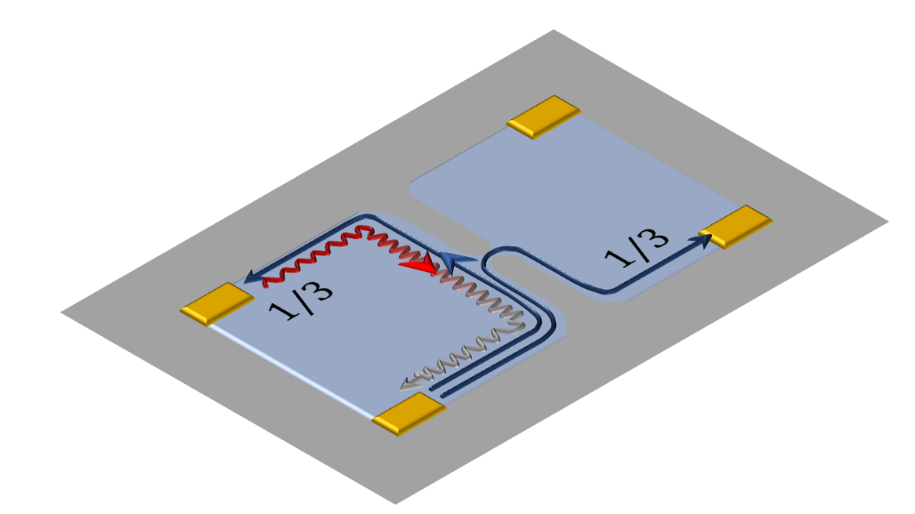
2/3 e - h conjugate state
n
e
h
n
e
h
e/3
e/3
G = 2/3 G₀
edge reconstructed
no partitioning on plateau ?
vacuum

Slide 18
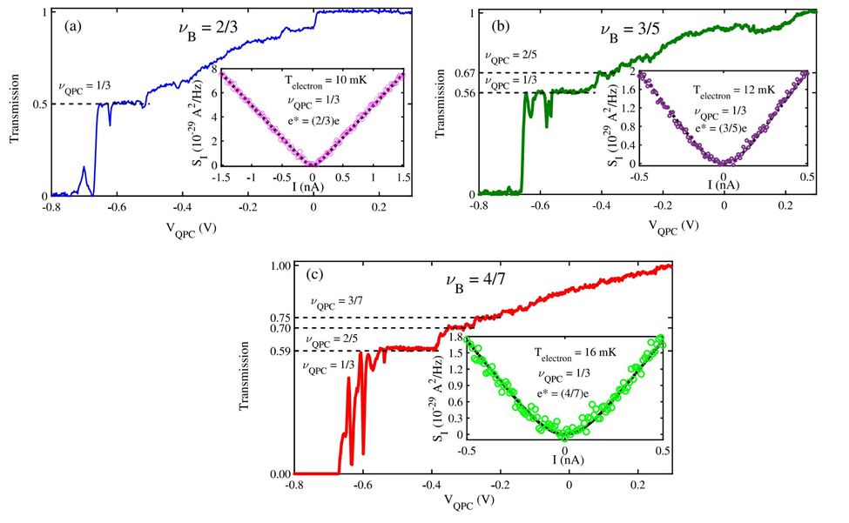

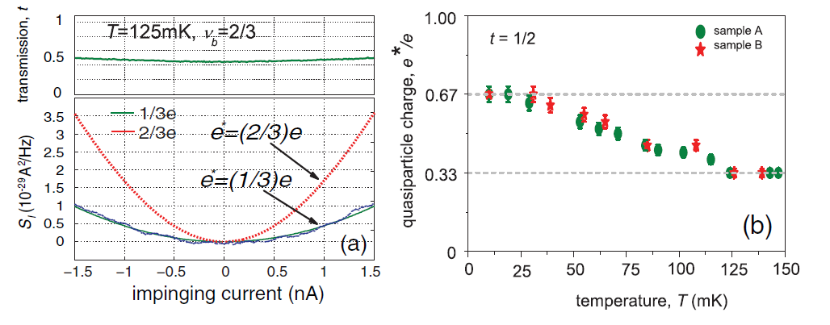
2/3 e - h conjugated state
F= 2/3
F= 2/3
F=2/3
F=1/3
noise on plateau
F = 2/3
Bid, Nature 2010
Banerjee, Nature 545
Fano…..temperature dependence
noise on plateau…. due to neutrals (?)

Slide 19
4/7 e - h conjugated state
1
0.8
3/7
n
o
2/5
i
s
0.6
s
i
1/3
m
s
n
0.4
edge reconstructed
a
r
T
Fano = 4/7
_{on all plateaus}
0.2
0
-0.8
-0.6
-0.4
-0.2
0
0.2
V
Banerjee, Nature 545
QPC
(V)
Fano=4/7
Fano=4/7
Fano=4/7
ν_{qpc} = 1/3
ν_{qpc} = 2/5
ν_{qpc} = 3/7
same at ν=3/5……F=3/5
Bhattacharyya, Banerjee
PRL (2919)

Slide 20
3/5 e - h conjugate state
Banerjee et al
edge reconstructed
Fano = 3/5
F= 3/5
_{‘on’ and ‘off’ plateau}
Bhattacharyya, Banerjee
PRL 2019

Slide 21
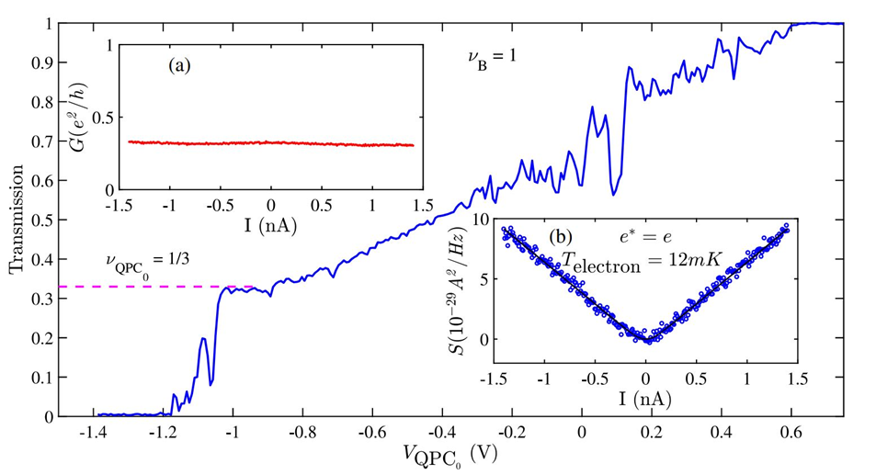
even at ν=1 …
F= 1
edge reconstruction to 1/3 and 2/3
upstream neutral is found
Fano = 1

Slide 22
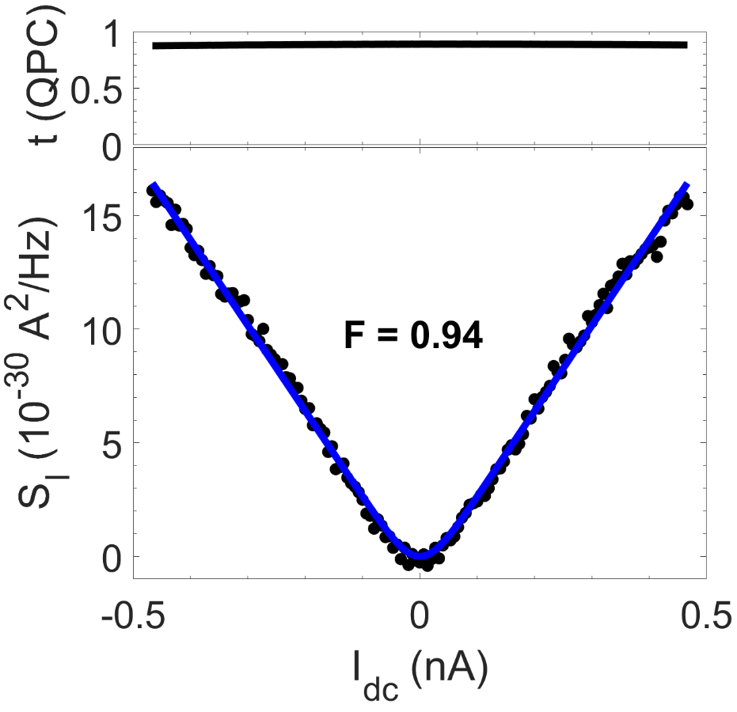
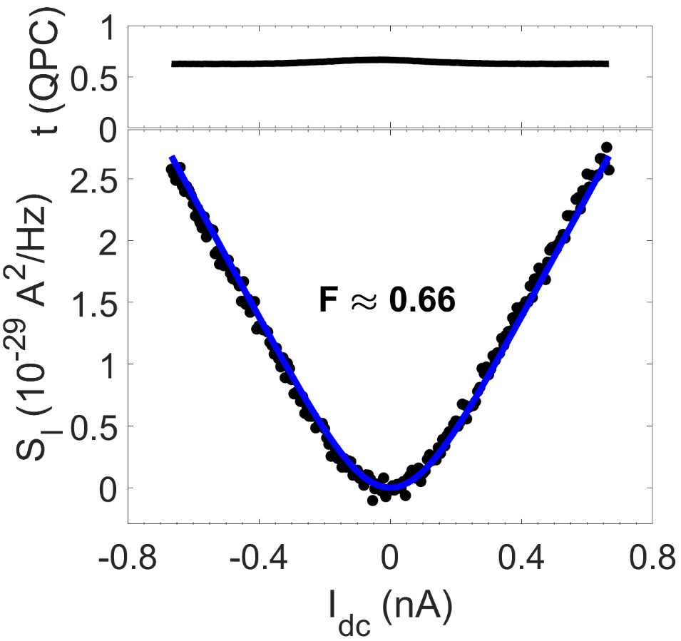
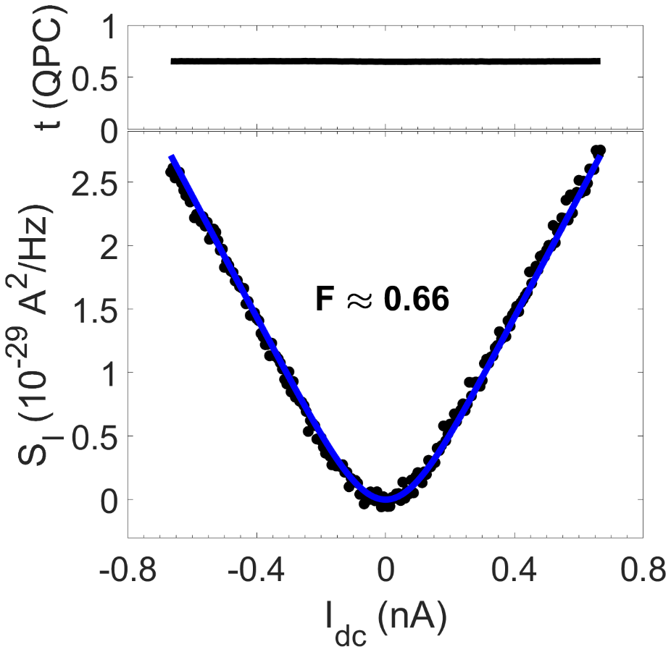




$ν=$ 1
$ν=$ 2/3
$ν=$ 2/3
1/3
1/3
2/5
$$I_{dc}$$
$$I_{dc}$$
$$I_{dc}$$
ν=2/3
ν=1/3
ν=4/15
F ≈ 1
F ≈ 0.66
F ≈ 0.66
FF
Biswas, Nat. Phys. 2022

Slide 23
the Bulk says it all
is there a fundamental reason
shot noise Fano = Bulk Filling
Fano ≠ fundamental charge

Slide 24
interference

Slide 25
interference with edge modes
electrons directed along definite paths
flexible design
edge modes enclose a definite area
minimizes phase averaging, high visibility fringes
no back-scattering insensitive to impurities

Slide 26
how to fool edge channels to interfere ?
X
B
will not interfere

Slide 27
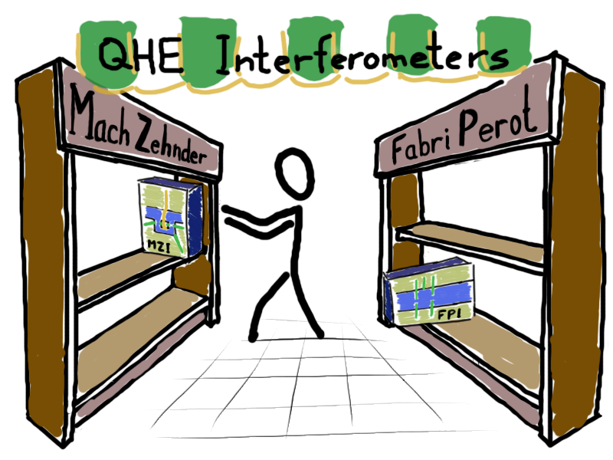
y

Slide 28
Mach - Zehnder

Slide 29
Complex Nature of Quasiparticles Charge: Beyond Their Elementary Values
New Paradigm: Bunching and Dissociation
common QHE interferometers
NOVEL optical-like Mach-Zehnder Interferometer (OMZI)
interference of particle-like states ΔΦ=(e/e*)Φ₀
NO bunching
interference of particle-hole conjugated states
coherent bunching ΔΦ=ν⁻¹ Φ₀
controlled dissociation ΔΦ=(e/e*)Φ₀
?

Slide 30
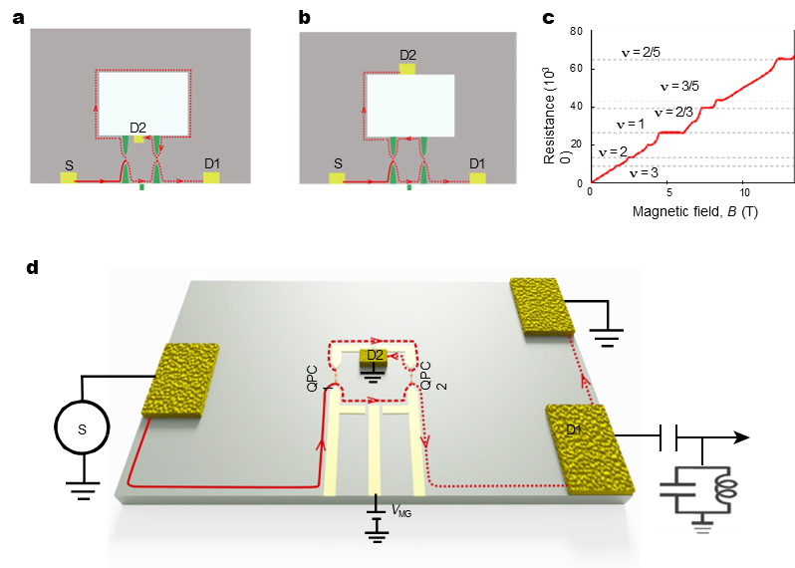
MZI FPI
FPI
large QD
Coulomb domination
multiple trajectories
ΔΦ = (e/e*) Φ₀
MZI
pure AB
counter-propagating trajectories
inner Drain
ΔΦ = Φ₀
Yang Ji, Nature (2003)

Slide 31
Electronic Mach–Zehnder interferometer
non-optical-like
3.67 μm²
1.2 × 10¹¹ cm^{–2}
3.7 μm²
1.2 × 10¹¹ cm^{–2}
Yang Ji, Nature (2003)

Slide 32
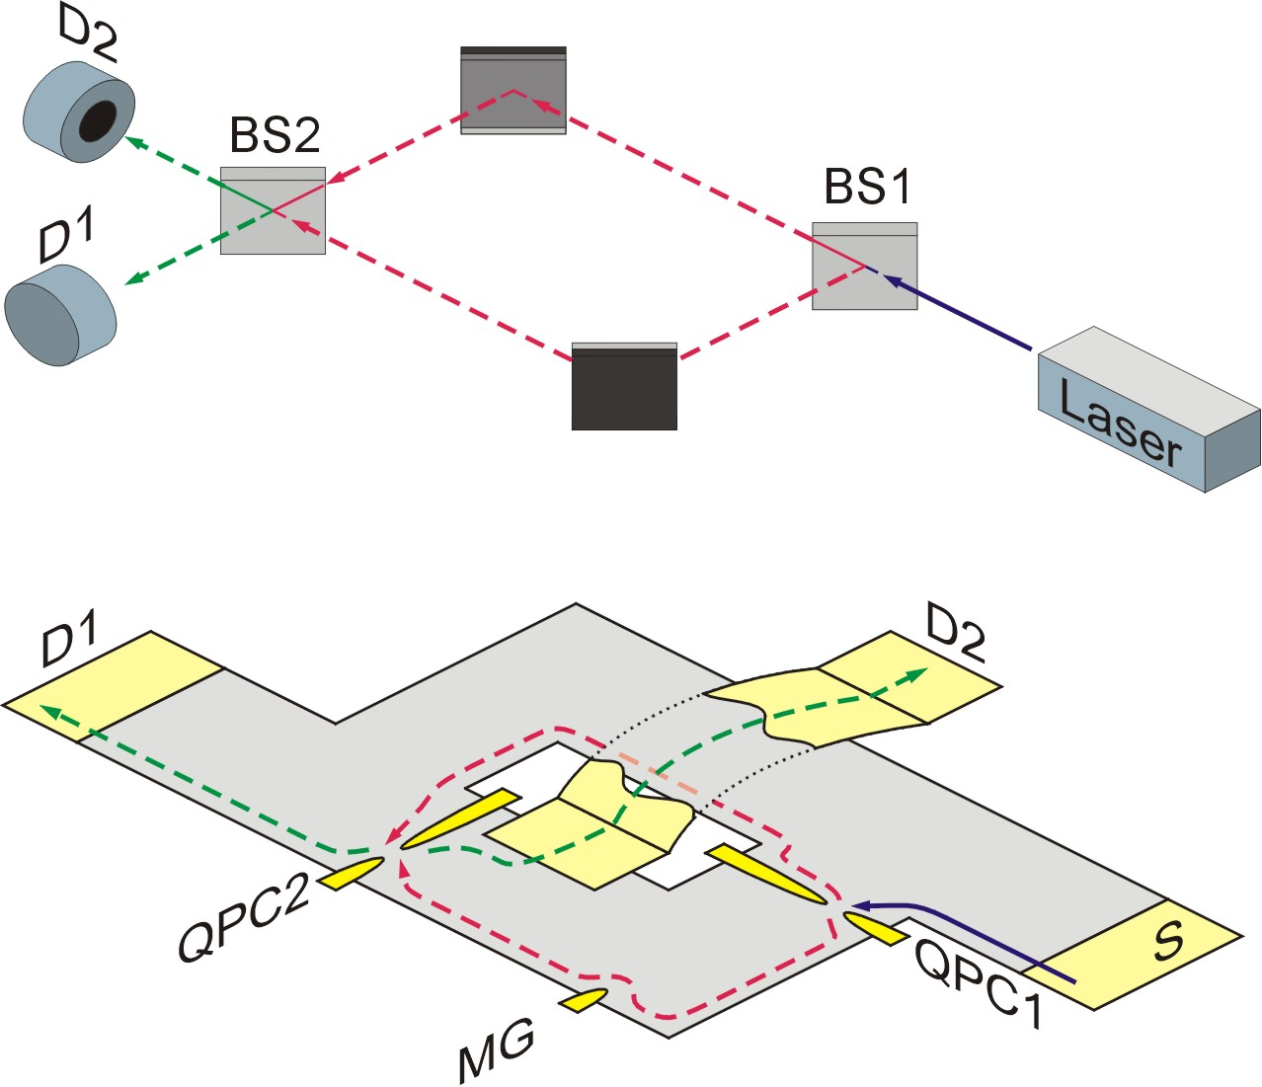


optical MZI
Optical MZI
co-propagating modes
two detectors outside
$$+ rre^{ikx_{d}}$$
$$A_{D1 }=tte^{ikx_{u}}$$
$${\left|A_{D1 }\right|}^{2}=T^{2}+R^{2}+2RT\cos{k\left(x_{d}−x_{u}\right)}$$
0
1π
2π
3π

Slide 33
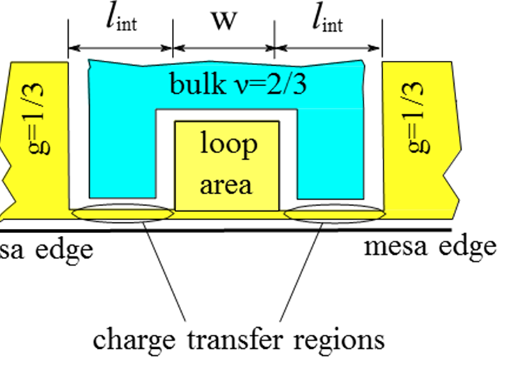
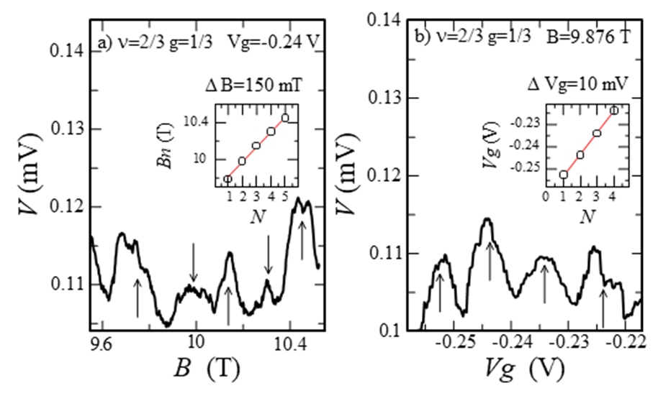
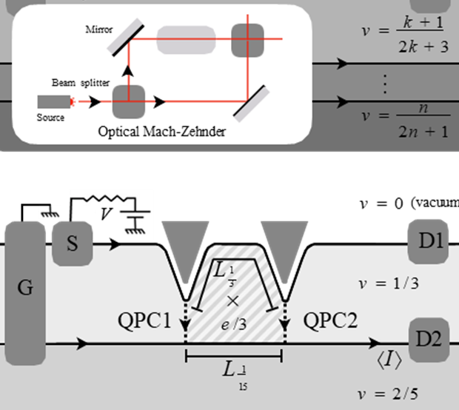
the trigger for an electronic co-propagating MZI …..
Quantum Hall Mach-Zehnder interferometer at fractional filling factors
E.V. Deviatov, Europhysics Letters 100 (2012)
Anyonic Mach-Zehnder interferometer on a single edge
of a two-dimensional electron gas
D. Feldman, Physical Review B 108 (2023)

Slide 34
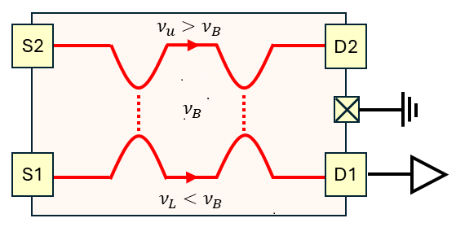
OMZI, based on interfering interface modes
ν_{U}…… ν_{B}…… ν_{L}
^{2/3 1/3 0}
^{1 1/3 0}
^{2/5 1/3 0}
periodicities & shot noise
depend only on ν_{B}
Shot noise does not always provide the quasiparticle charge, Biswas, Nat. Phys. (2022)

Slide 35
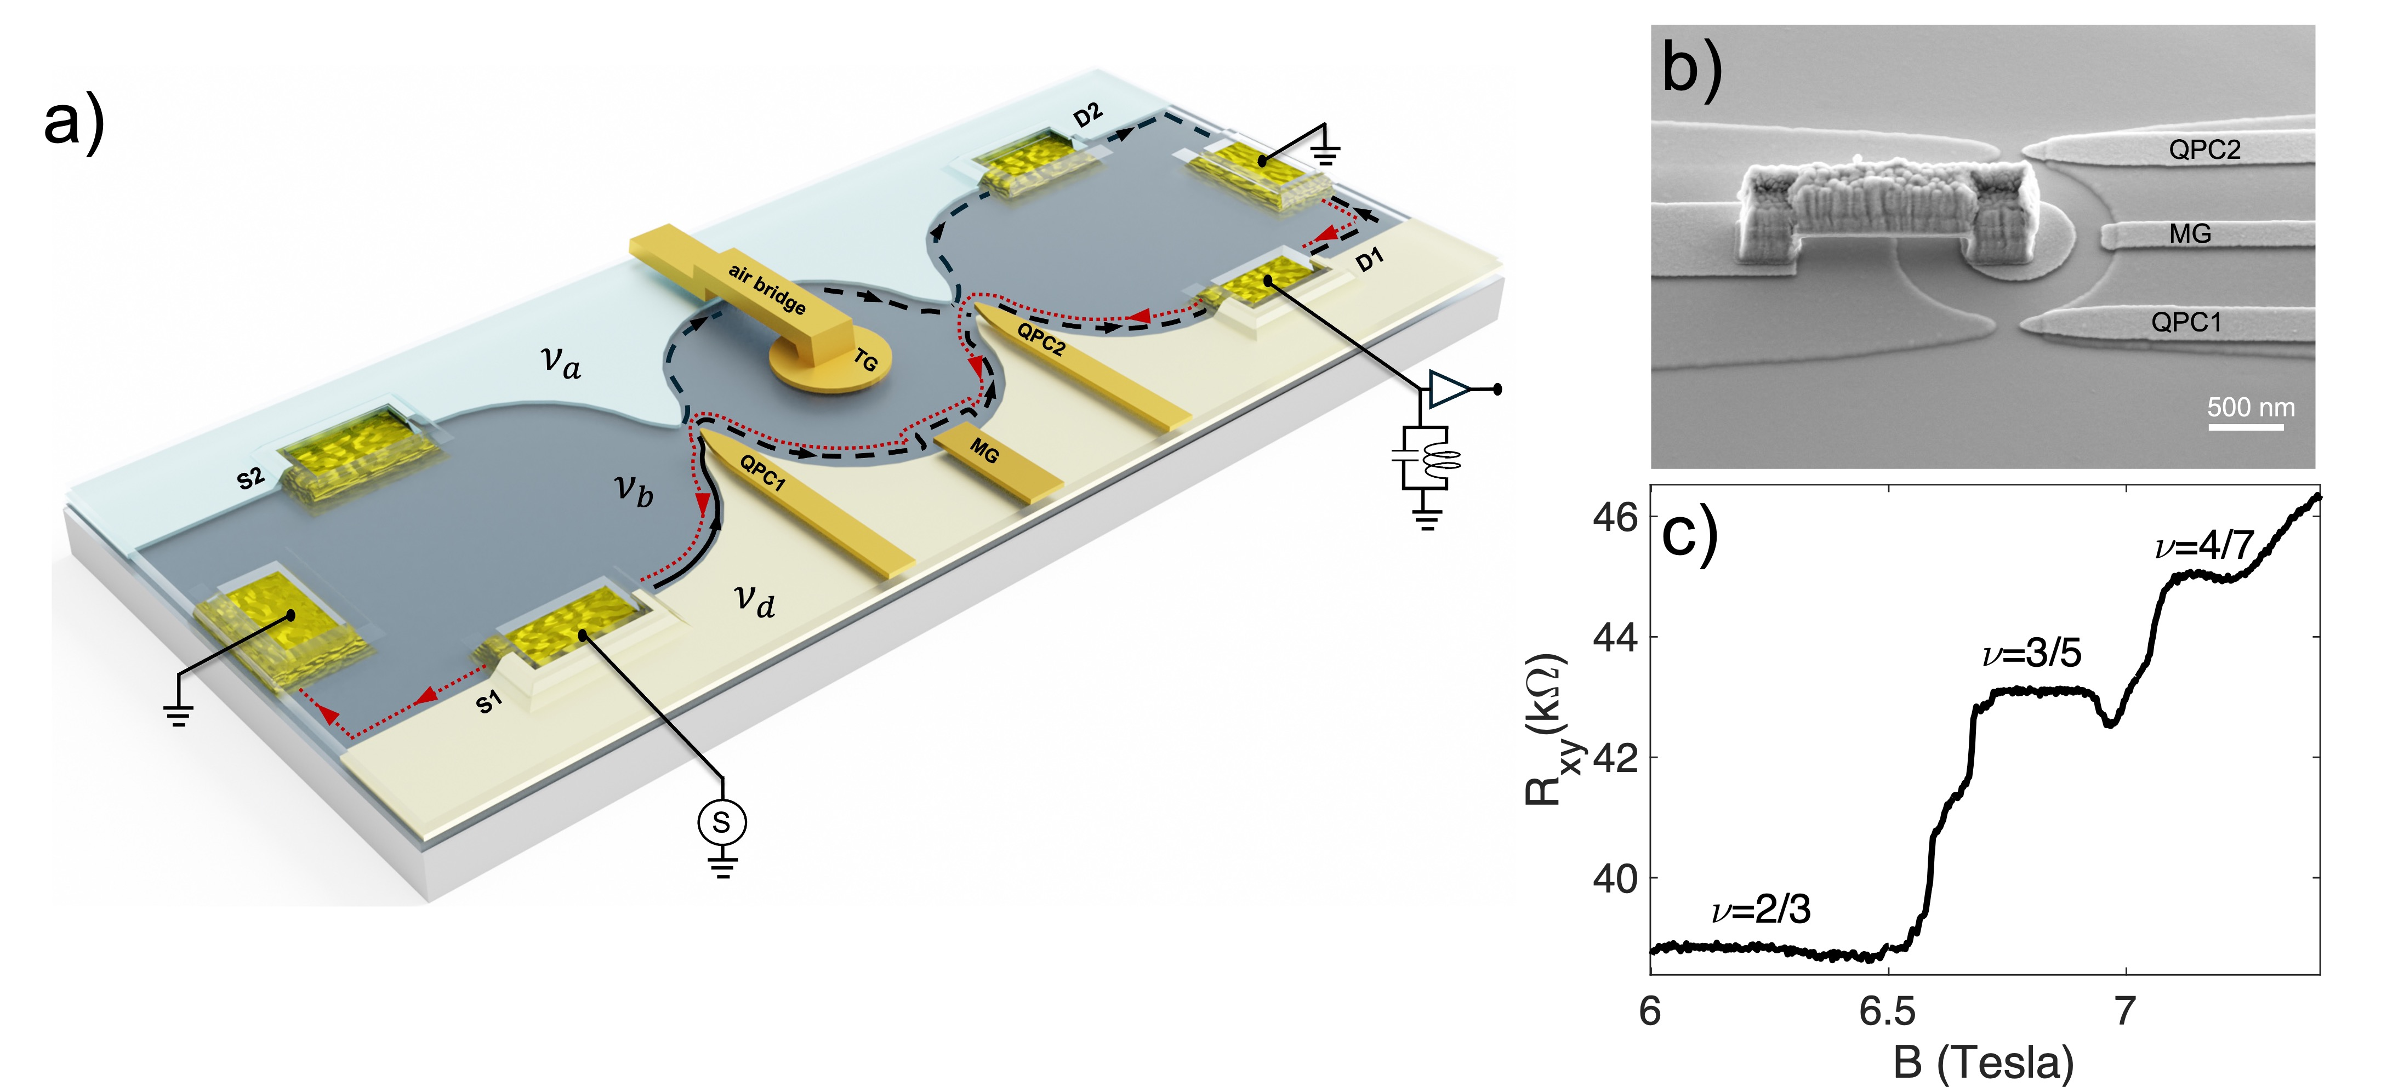
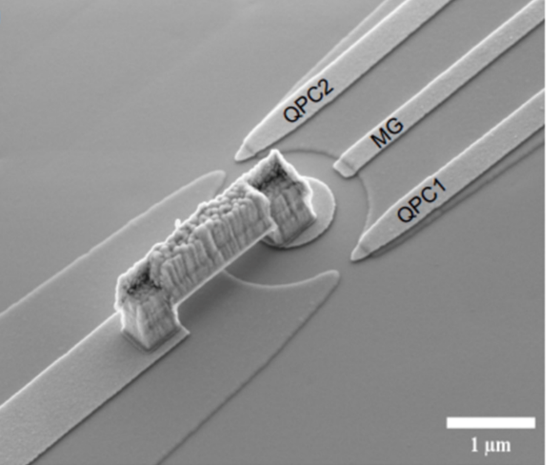
co-propagating OMZI w/ neutral
TG = dot or antidot
A=3µm²
path length~ 1µm
TG area = 0.785µm

Slide 36
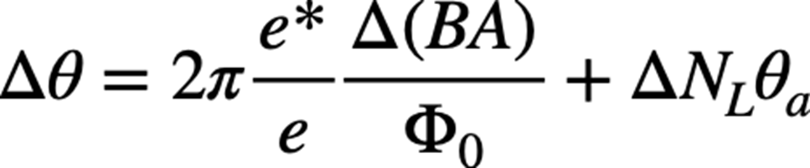
expected periodicity and phase slips
FPI and OMZI
FPI Fully or partially closed Trajectories = Localized Quasiparticles = N
ΔB Δ N ….leading to phase slips
OMZI Trajectories extend beyond the central island = Not Localized
ΔB … no phase slips
Expected periodicity…. ΔΦ=(e/e*)Φ₀
e*= fundamental (elementary) fractional charge

Slide 37
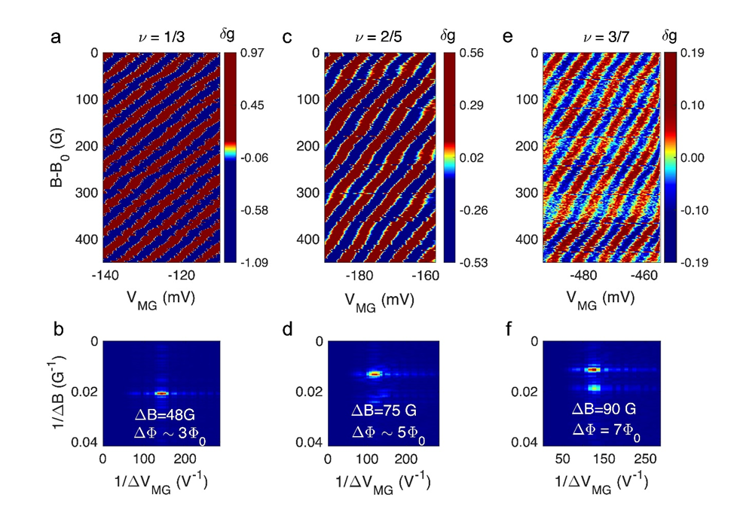
Aharonov Bohm (AB) pajamas…ν = 1/3, 2/5, 3/7
e*= e/3, e/5, e/7
ν_{a}-ν_{b}-ν_{d} 2/3-1/3-0, 1-2/5-0, 1-3/7-0
T=15-20 mK
V_{TG} = 0
pajama without phase slips
QPC filling = innermost mode of edge channel

Slide 38
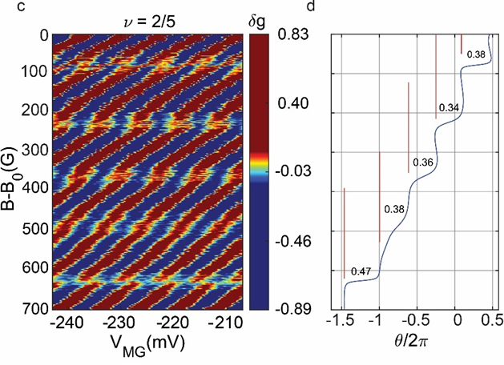
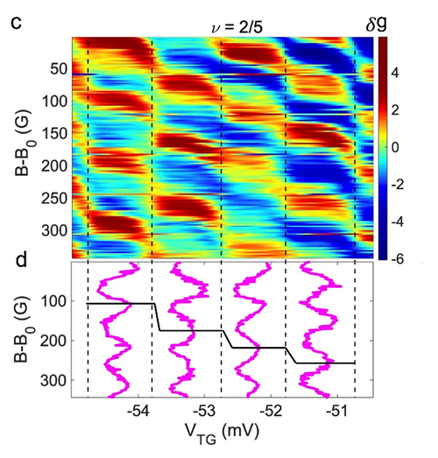

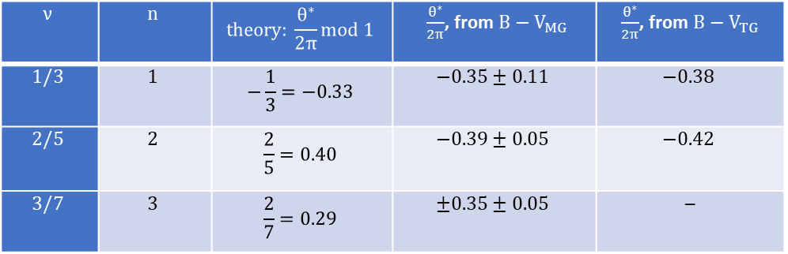
example….interference and phase slips, V_{TG} ≠ 0
$$\frac{θ^{∗}}{2π}=\frac{2}{1+2n}$$
$$ν$$ | $$n$$ | $$theory: \frac{θ^{∗}}{2π}mod 1$$ | $\frac{θ^{∗}}{2π}$, from $B−V_{MG}$ | $\frac{θ^{∗}}{2π}$, from $B−V_{TG}$
$$1/3$$ | $$1$$ | $$−\frac{1}{3}=−0.33$$ | $$−0.35±0.11$$ | $$−0.38$$
$$2/5$$ | $$2$$ | $$\frac{2}{5}=0.40$$ | $$−0.39±0.05$$ | $$−0.42$$
$$3/7$$ | $$3$$ | $$\frac{2}{7}=0.29$$ | $$±0.35±0.05$$ | –

Slide 39
Fabry - Perot

Slide 40
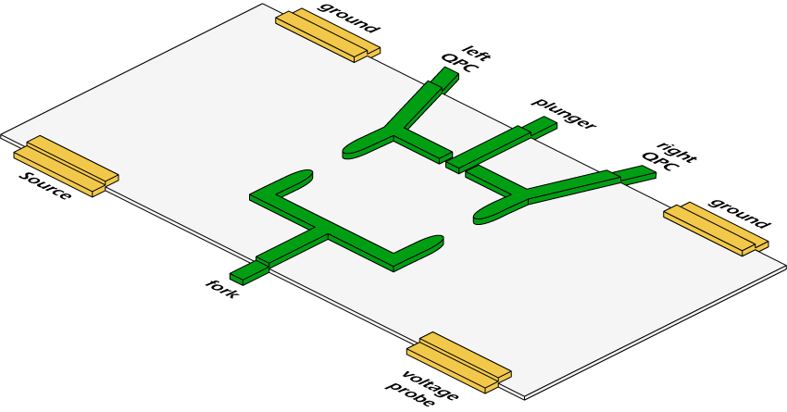



electronic FPI
optical FPI
BS
S
in the limit of only two-path interference

Slide 41
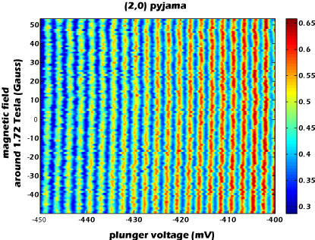
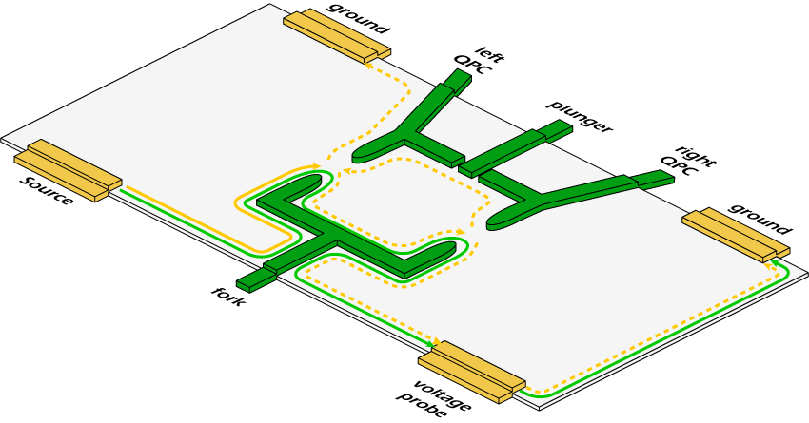
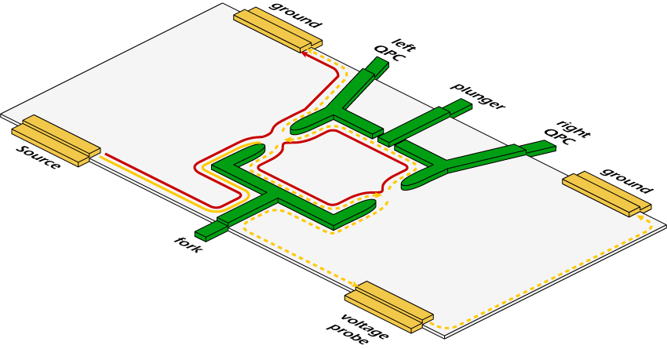
bare FPI – Coulomb dominated (CD)
(2,0)
interfering the lowest Landau level
no B dependence
flux remains constant

Slide 42
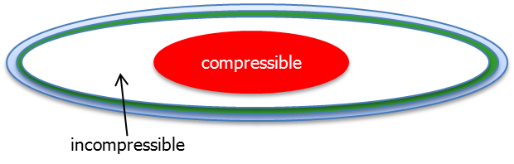
CD dominated
c<<
c<<
c>>
N ^{th} state
large charging energy needed to add an electron to the leads

Slide 43

FPI in CD regime – insufficient screening
A
B
E_{F}
electrons cannot be added from the leads
number of electrons in outer state = constant
hence, all states shrink
(A -ΔA )(B +ΔB )= constant
after Φ₀ a new qp added in the lowest LL
electron is added to outer state from bulk
A-ΔA
B +ΔB
E_{F}
positive donors
Halperin 2011

Slide 44


interference of outer-most edge mode
MZI
FPI
increasing area

Slide 45

FPI CD →→ AB
-- grounded ohmic contact
-- top gate

Slide 46
mixed regime ….. AB →→ CD
AB
intermediate
CD
B-field
B-field
B-field
Gate
Gate
Gate

Slide 47
AB →→ CD
intermediate regime controlling screening
Sivan 2016)

Slide 48

AB →→ CD
CD oscillations preserves hidden coherence ?

Slide 49
AB →→ CD

Slide 50
expected interference
in the fractional regime

Slide 51

lack of interference of qp…..
small edge velocity → extended duration in interferometer
interaction with uncontrolled environment
small edge velocity (small electric field) → level spacing < k_{B}T
built-in ‘which path’ detection via the ‘neutral modes’
increasing edge velocity………….sharpening the edge
eliminating edge reconstruction somehow ?

Slide 52
anyonic statistics
phase is comprised of AB + statistical phases
Halperin 2011
Chamon 1997

Slide 53
anyonic statistics
N _{B}

Slide 54

anyonic statistics

Slide 55

recent report on AB oscillation in v =1/3
two additional 2DEGs used as screening layers

Slide 56
fractional quantum states…
predicted to host:
fractionally charged quasiparticles….PROVED
unusual fractional statistics………NEVER PROVED

Slide 57
without interference in fractional states…
thermal transport may distinguish
non abelian vs abelian

Slide 58


quantum Hall effect……even denominator fraction
unexpected…

Slide 59

with time…

Slide 60

what may happen at v =1/2 ?
two flux quantum per electron
symmetric Shubnikov de Haas oscillations around v =1/2
an effective B_{1/2}=0 ….. ?

Slide 61
composite fermions (CFs) model
Jain, 1989
flux attachment
2Φ₀
composite fermion
Φ₀ Φ₀
B
e⁻
B_{1/2}
n_{e}
e
Fermi liquid of electrons at B_{1/2}
external field canceled
mean field approximation
B_{1/2}
CFs feel a reduced lower field, B –B _{1/2}
independent particles
B _{1/2} = 2n_{e}Φ₀

Slide 62
integers of CF →→ fractions of e
B=B_{1/2}+ΔB → ν_{CF} = (B – B_{1/2}) / n_{e}Φ₀
ν_{CF} = 1, 2, 3 ν_{e} = 1/3, 2/5, 3/7
CF
Φ₀ Φ₀
e

Slide 63
Moore - Read theory 1991
ν=5/2 = 2+1/2
ΔB =0
B_{ext}
metal
superconductor
exotic phase
fermions at B =0
R_{xx}=0
p-wave Cooper pair
BCS of polarized composite fermions
w/ odd orbital angular momentum

Slide 64
consequently, for ν =1/2…
Φ₀*=h/2e
I
ε(θ )
=e / 4
measured

Slide 65


5/2 state Moore – Read, Pfaffian state
adding flux Φ₀/2 induces a vortex in the p-wave BCS condensate
e /4 + zero-energy quasiparticle (Majorana) - an Andreev state in the vortex
‘bulk – edge correspondence’ → e /4 + Majorana-like edge mode……+ 2 integer modes
fermion edge e/4 + Majorana

Slide 66
zero energy Majorana anyons
chargeless and spinless
particle = anti-particle
occupied & unoccupied at zero energy
Majorana’s come in pairs….. γ₁ ± i γ₂
forming delocalized fermionic state
ground state degeneracy of n vortices……. 2^{n/2}
non-abelian state…

Slide 67
exchange statistics due to ground state degeneracy
degenerate ground state
exchange → unitary
non-abelian anyons

Slide 68
on non-abelian states…
degenerate ⏐g.s.⟩ & protective gap
exchange leads to unitary operations
insensitive to path
robust states against decoherence…..delocalized fermion

Slide 69
interest in ‘Majorana’ in condensed matter
results from its expected non-abelian statistics
and, ‘decoherence free’ computation
Moore - Reed proposed localized Majoranas in bulk vortices and Majorana as edge mode
( Kitaev proposed Majorana states at edges of 1d p-wave SC )

Slide 70
exchange statistics can be verified
via braiding interference of quasiparticles
Proposed Experiments to Probe the Non-Abelian ν=5/2 Quantum Hall State
A. Stern and B. I. Halperin
Detecting Non-Abelian Statistics in the ν=5/2 Fractional Quantum Hall State
P. Bonderson, A. Kitaev, and K. Shtengel
Electronic Mach-Zehnder interferometer as a tool to probe fractional statistics
K. T. Law, D. E. Feldman, and Yuval Gefen
Shot noise in an anyonic Mach-Zehnder interferometer
D. E. Feldman, Yuval Gefen, Alexei Kitaev, K. T. Law, and A. Stern
Fractional Quantum Hall Effect and Multiple Aharonov-Bohm Periods
D.J. Thouless and Y. Gefen
Hanbury Brown and Twiss Correlations in Quantum Hall Systems.
G. Campagnano, O. Zilberberg, I. V. Gornyi, Y. Gefen

Slide 71

interference was reported by a few groups
Willet (v =5/2), Goldman (v =1/3), Kang (v =5/2)
not reproduced
our typical results
fractional

Slide 72
thermoelectricity
electric current
heat current
J_{q} =dq_{charge}/dt
J_{th} =dQ_{heat}/dt
here, we concentrate on…

Slide 73
Pendry’s theory for 1D heat transport
1D ballistic channel
non-interacting particles
J. B. Pendry
Quantum limits to the flow of information and entropy
J. Phys. A: Math. Gen. 16, 2161-2171 (1983)
universal upper limit of information transfer
entropy = log 2 x information
thermal energy = temperature x entropy
upper limit of thermal conductance…….in ballistic regime

Slide 74
1D ballistic transport
quantum of thermal conductance

Slide 75
Weideman – Franz ballistic 1D channel
for non-interacting electrons

Slide 76



past experiments…. non-interacting
16 phonon modes single photon mode single electron mode (IQHE)
Schwab et al. 2000 Meschke et al. 2006 Jezouin et al. 2013
Weideman – Franz

Slide 77

1D modes in QHE
bulk of QHE …………localized quasiparticles → incompressible
edge of IQHE ………’integer’ 1D chiral edge modes G_{H} =v e ²/h , v =1, 2, 3,…
edge of FQHE ……..’fractional’ 1D chiral edge modes
abelian states ……….. odd denominator v =1/3, 2/5,.., 2/3, 3/5, 4/7,…
non-abelian state ..…….. even denominator v =5/2,…

Slide 78
Pendry’s general theory of non-interacting particles in 1D
was extended for interacting particles
Kane, C. L. & Fisher, M. P. A.
Quantized thermal transport in the fractional quantum Hall effect
Phys. Rev. B 55, 15832–15837 (1997)
interactions should not affect
the thermal conductance
Κ = κ₀
_{Weideman - Franz breaks down}

Slide 79
generality of 1D thermoelectric coefficients
Rego, G.C and Kirczenow, G
Fractional exclusion statistics and the universal thermal conductance: A unifying approach
Phys. Rev. B 59, 13080-13086 (1999)
g = 0 bosonic
g = 1 fermionic
g = 3 v = 1/3
Haldane

Slide 80
thermal conductance in FQHE…predictions
topological constant - determined by bulk wavefunction (CFT , X. G. Wen )
‘bulk – edge correspondence’
reveals the NET chirality of modes (in equilibration → downstream minus upstream )
for long propagation length
insensitive to edge reconstruction (details of edge potential)
AND….

Slide 81
non-abelian states
harboring Majorana excitations
each Majorana = half fermion
K_{non-abelian} = κ₀ (n + ½)

Slide 82

electrons
neutral…….bosonic
Majorana….κ₀/2
fractional

Slide 83
the experiments

Slide 84



working principles
charges
phonons
in equilibrium ……. ΔP =
hot reservoir
cold reservoir
J_{q}
Tm
T0
1D electronic modes
dissipated power, ΔP
β = (3-7) nW K⁻⁵
Wellstood, F. C., Urbina, C. & Clarke, J.
Hot-electron effects in metals.
Phys. Rev. B 49, 5942–5955 (1994)
input power

Slide 85

replacing
heating reservoir w/ current …
V_{in} , I_{in}
G_{Hall}
ΔP =P_{in} - P_{out}
I_{out} = I_{in} / 2 + I_{in} / 2 = I_{in}
V_{m} =V_{in} /2
P_{out}=P_{in} /2
ΔP= P_{in}-P_{out}=P_{in} / 2
Jezouin et al. Science 2013

Slide 86
N - arm device
3
Iin
dissipated power
Vin
1
Tm
2
4
N =4

Slide 87
we measure only temperature…
electron temperature in grounded contacts…..T₀
electron temperature in heated reservoir…….T_{m}
small T……….phonon term irrelevant
high T………..phonon term subtracted
K determined

Slide 88
measuring temperature
temperature in grounded contacts…..T₀
shot noise
excess temperature in heated reservoir…….T_{m} - T₀
thermal noise

Slide 89
measuring T₀ …… shot noise
I_{S}
t
e*=2e/3
± 0.5mK

Slide 90
measuring T_{m} ……Johnson-Nyquist noise
Tm
current fluctuations
A
dissipated power, ΔP
4k_{B}T_{m}G
modes leave contact with noise 4k_{B}T_{m}G
even if modes cool down with distance…
thermal noise is conserved

Slide 91


measuring T_{m} ……excess Johnson-Nyquist noise
measured noise
power dissipation

Slide 92
determining thermal conductance
calculated dissipated power
subtracting procedure
same T_{m}
phonon contribution subtracted

Slide 93


subtracting procedure
subtracting channels at T_{m}*
N = 2
N = 4

Slide 94


getting K /κ_{0 ……an example}
κ₀
T₀²

Slide 95
realization…….N = 4
QPC2
5µm
QPC1
QPC3
Iin
A
source
QPC4

Slide 96
realization…….N = 3
QPC pinched
Iin
A

Slide 97
heart of structure
N =2 v =2 v_{QPC}=1

Slide 98

typical structure

Slide 99
points of consideration
electrons equilibrate in small floating reservoir T_{m}
hence, outgoing current carries only Johnson - Nyquist noise
without shot noise
assuring no bulk energy modes bulk plays as an uncontrolled ‘channel’
arms are long enough ~150µm, allowing temperature equilibration
equal splitting between arms, accurate amplifier gain, small contact resistance, …

Slide 100
measuring G_{th} → not as accurate as G_{q}
measuring G_{q} =v e ²/h simple and accurate …….. accuracy 10⁻⁹
getting the correct G_{th} requires:
temperature accuracy <1mK
‘ideal’ micrometer ohmic contact
zero bulk thermal conductance
‘infinite’ propagation length for thermal equilibration
………our accuracy ~0.04κ₀

Slide 101
integers.…………………v = 1, 2
lowest Landau level
particle-like fractions.…..v = 1/3
hole-like fractions……….v = 2/3, 3/5, 4/7
first excited Landau level
v = 7/3, 5/2, 8/3

Slide 102

Κ in FQHE regime…Kane & Fisher 1997
v =1 → κ₀
1 electron mode
v =1/3 → κ₀
1 CF mode

Slide 103


T₀=30mK

Slide 104
integers v = 2
ΔN (0.98±0.03) κ₀

Slide 105


particle-like v =1/3
ν
x
edge
bulk: gapped - incompressible liquid
expected……Κ = κ₀
edge: single charge mode G=G_{H} /3

Slide 106
κ_{o}
‘subtraction procedure’

Slide 107
more complex fractions…
fractional hole-conjugate states……1/2 < v < 1
full Landau level with holes
hence, counter-propagating modes
always with upstream neutral modes
v = 2/3, 3/5, 4/7

Slide 108



hole - conjugate ν = 2/3
non-equilibrated
e_{downstream} - e/3_{upstream}
Κ = 0
G=(4/3)G_{H}
MacDonald, A. H.
Edge states in the fractional quantum Hall effect regime
Phys. Rev. Lett. 64, 220–223 (1990)

Slide 109

hole - conjugate ν = 2/3
equilibrated
2e/3_{downstream} + neutral _{upstream}
Kane, C. L., Fisher, M. P. A. & Polchinski, J.
Randomness at the edge:
theory of quantum Hall transport at filling 2/3
Phys. Rev. Lett. 72, 4129–4132 (1994)
Κ = 0

Slide 110
1D modes in QHE
downstream charge……………………………particle - like
downstream charge + upstream neutral …hole – conjugate & non - abelian

Slide 111
equilibration of counter-propagating charge modes
topological neutral modes
modes carrying energy zero net charge
invisible in conductance measurements
associated only with particular FQHE states

Slide 112



excitation of neutral modes at ohmic contact
qp
‘back side’ of ohmic contact
He4 bubbles
upstream
hot spot
E_{F}+eV_{n}
μ
E_{F}
U. Klass, W. Dietsche, K. von Klitzing & K. Ploog
Image of the dissipation in gated
quantum Hall effect samples
Surface Science 263, 97-99 (1992)
dissipated power = 0.5 I_{n}V_{n}

Slide 113

detecting topological upstream neutral edge modes
due to edge reconstruction
in short distance
via shot noise
ν = 2/3, 3/5, 1+2/3, 2+2/3 & 5/2
Bid, Nature (2010), Dolev, PRL (2011),…..
QD thermometry
ν = 2/3 edge at ν = 1 + bulk heat transport
Venkatachalam, Nature Physics (2012)
QD thermoelectric current
ν = 2/3
Gurman, Nature Comm. (2012)
QD thermometry
ν = 1+1/3 + bulk heat transport
Altimiras, PRL (2012)

Slide 114
v =2/3 …… why Κ = 0 ?
I_{S}
hot upstream neutral mode
hot downstream 2e/3 charge mode
G
T_{m}
G
neutral heat returns
charge heat returns
cold downstream charge mode
cold upstream neutral mode
equal number of down and up modes
full equilibration at large length…..all emitted heat returns

Slide 115
v =2/3
T_{m}
d
non-interacting
T₀
u
L
T_{m}
interacting
long equilibration length, ξ
modes do not equilibrate
ξ
T₀
equal number of down and up modes
heat diffuses in v =2/3
length dependence thermal conductance
‘thermal conductivity’

Slide 116



v =2/3, heat conductance w/length

Slide 117

Κ hole – conjugate states…Kane & Fisher 1997
v =2/5 → 2κ₀
predicted….’bulk-edge’ correspondence
2 CF modes
v =2/3 → Κ=0
1 charge down + 1 neutral up
v =3/5 → Κ=-κ₀
1 charge down + 2 neutral up
v =4/7 → Κ=-2κ₀
1 down charge + 3 neutrals up

Slide 118

v =3/5
T_{m}
d
T₀
non-interacting
unequal number of down and up modes
thermal conductance
T₀
L
interacting
short ξ
nodes equilibrate
ξ

Slide 119
v =4/7 → ⏐-2κ₀ ⏐
κ₀
v =3/5 → ⏐-κ₀ ⏐
v =2/3 → κ >0
hole-conjugate states

Slide 120
K_{3/5} …found temperature independent

Slide 121
1D modes
fractional and neutral
K = κ₀

Slide 122


Slide 123
fractional states in first excited Landau level
v = 2 + η
v = 7/3, 5/2, 8/3

Slide 124
1st excited Landau level
µ ≈ 30 x 10⁶ cm²/v-s
2 11/5 7/3 12/5 5/2 8/3 14/5 3
parallel bulk thermal conductance (via electrons in donor layers)

Slide 125

doping for X-high mobility 2DEG
states are affected by long-range scattering from ionized dopants
improve spatial correlation & screening via excess free electrons at donor layers
Pfeiffer 2000’s
short period AlAs/GaAs super-lattice (SPSL)

Slide 126

non-standard MBE growth
low x(Al) in the doping layers (shallow DX centers)
less proliferation of fractional states
NO bulk thermal conductance
stable gates (QPCs replaced by continuous gates)
improved floating ohmic contact

Slide 127

5/2
PH-Pfaffian
7/3
8/3
no parallel bulk thermal conductance

Slide 128

measured
v =7/3 v = 2 + 1/3 particle like, downstream K = 3κ₀
v =8/3 v = 2 + 2/3 hole-like, down + up K = (2+ε)κ₀
what do we know ?……….v =5/2 v = 2 + ½
quasiparticle charge e^{*=}e /4
upstream energy modes
spin polarized
K = ?
neutral
fermionic
upstream
Majorana

Slide 129
v =5/2 state …….. if non-abelian K/κ₀ =n +1/2
from electrons ….. to non-abelian quasiparticles
half - filled LL on top of two filled LL’s………. 2 ½ = 2 + ½
flux attachement……spin polarized CFs
at zero average magnetic field
CFs pair into Cooper pairs
p-wave superconductor
vortices are charged…..e*=e /4 + Majorana
chiral edge modes: charged + Majorana
ground state degeneracy (braiding is non-abelian)
ΔB_{1/2} =0
Cooper pair

Slide 130
abelian
non - abelian
SU(2)₂ |  | κ = 4.5
Pfaffian |  | κ = 3.5
PH - Pfaffian |  | κ = 2.5
Anti - Pfaffian |  | κ = 1.5
Anti - SU(2)₂ |  | κ = 0.5
331 |  | κ = 4
K =8 |  | κ = 3
113 |  | κ = 2
Anti-331 |  | κ = 1
integer, e, κ = 1
fraction, e/4, κ = 1
neutral, 0, κ = 1
Majorana, 0, κ = 0.5
upstream neutral

Slide 131
three thermal cycling
17 measurements
different temperatures
three location of the 5/2 plateau

Slide 132


Slide 133

thermal conductance determination via
‘subtraction procedure
ΔN = 4 - 2

Slide 134

conductance determination with
phonons contribution

Slide 135

SU(2)₂
increasing equilibration length at lower temperature
Pfaffian
PH-Pfaffian
PH - Pfaffian
v=8/3
Anti - Pfaffian
Anti - SU(2)₂
v=2/3

Slide 136
5/2
PH-Pfaffian
7/3
8/3
3κ₀
2.5κ₀
2.15κ₀

Slide 137
abelian
non - abelian
SU(2)₂ |  | κ = 4.5
Pfaffian |  | κ = 3.5
PH - Pfaffian |  | κ = 2.5
Anti - Pfaffian |  | κ = 1.5
Anti - SU(2)₂ |  | κ = 0.5
331 |  | κ = 4
K =8 |  | κ = 3
113 |  | κ = 2
Anti-331 |  | κ = 1
integer, e, κ = 1
fraction, e/4, κ = 1
neutral, 0, κ = 1
Majorana, 0, κ = 0.5

Slide 138
v = 5/2……..likely non-abelian
measuring thermal conductance
reveals hidden information

